Slide 1
QBIK Airlines– Technical Presentation
Date: 1st August, 2020
Presenter: Nidhi Kakar

Slide 2
What factors should be considered by Qbik Airline to influence customers decision to travel by this airline
If customer is not satisfied , it would mean losing customers resulting in lesser revenues for Qbik.
Increasing Competition has led to the need for ensuring high level customer satisfaction
Cost aggravation by increasing campaigns or improvising factors measuring satisfaction
Increase in cost due to campaigns or improvising factors for customers satisfaction still doesn’t ensure more customers flying by Qbik.

Slide 3
Customer Satisfaction can be ensured by identifying the key factors responsible for customer satisfaction
We have been provided with the data of customer satisfaction on 16 factors. Our any of the variables important enough to determine customers choosing the airline again
We try to identify top 2 or 3 factors which determine high customer satisfaction
We identify if any factor is correlated to another factor and affecting customers satisfaction level together
If we find multicollinearity then those variables need to be dropped from the regression analysis
We analysed the data base on the assumption that these variables are determining customer satisfaction. Provided we cannot prove this, we can conclude that customer satisfaction cannot be determined by the given factors
Provided we identify the key variables responsible for customer satisfaction, then can a function be created to determine customer satisfaction level

Slide 4
Descriptive and Statistical Approach were taken to find out the key factors determining customer satisfaction
What factors should Airline Company take into consideration in the coming Financial Year to influence the customers decision of travelling by this Airline
STATISTICAL APPROACH #1
STATISTICAL APPROACH #2

Slide 5
3 key factors could be identified responsible for customer satisfaction, enabling development of a multivariate equation capable of moderately identifying factors leading to overall customer satisfaction
Key Insights
The three key variables which determine passenger satisfaction for the airline are Online Boarding, Seat Comfort and Inflight Wi-Fi Service.
We do see some pre failure indications which might indicate understanding more variables to determine customer satisfaction.
Source: Qbik Airline Statistical Records

Slide 6
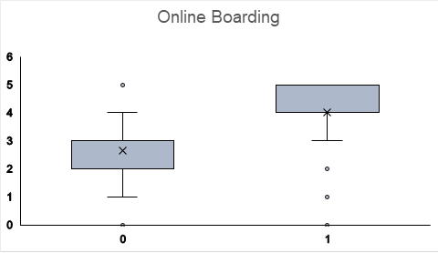
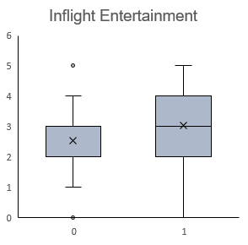
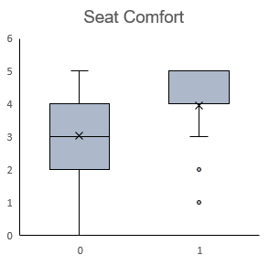
Descriptive Statistics Analysis- 3 prime factors could be identified
Key Insights
Online Boarding, Seat Comfort and Inflight Entertainment were three factors that are closely related to customer satisfaction or dissatisfaction.
Source: Qbik Airline Statistical Records

Slide 7
Inferential Statistics – Pearson correlation between variables and satisfaction
Pearson correlation between factors and satisfaction
Key Insights
Online Boarding is 50% correlated to satisfaction making it an important variable determining customer satisfaction.
On performing Partial correlation to check for strength between online boarding and other variables, we found it closely related to Inflight Wi-Fi service , ease of online booking and seat comfort.
This further corroborates our confidence in the trend picked up in our descriptive statistic analysis.
Source: Qbik Airline Statistical Records

Slide 8
Inferential Statistics – Variance Inflation factor
Key Insights
 | VIF
Type-travel | 1.97734
Class | 1.969182
Age | 1.157911
Flight Distance | 1.341752
Inflight Wi-Fi service | 2.415123
Ease of Online booking | 2.200839
Food and drink | 2.168084
Online boarding | 1.83869
Seat comfort | 2.366665
Inflight entertainment | 3.853828
On-board service | 1.761475
Leg room service | 1.305724
Baggage handling | 1.899503
Check in service | 1.216422
Inflight service | 2.062596
Cleanliness | 2.858807
Inflight entertainment and cleanliness were showing inflated correlation to satisfaction due to multicollinearity in the model
Hence we need to remove these variables from the model to ensure a good fit.
Source: Qbik Airline Statistical Records

Slide 9
Conclusion
Key Variables which determine passenger satisfaction for the airline are Online Boarding, Seat Comfort and Inflight Entertainment.​
Ease of Online Boarding accounts for 50% of passenger satisfaction independent of the control of all other independent variables .​
For those who responded to this survey, only 54% of the satisfaction could be explained by the variables together.​
Root mean Square Error of 0.33 depicts that we have obtained a moderate fit of the model to our dataset.

